Slide 1
Food Chains

Slide 2
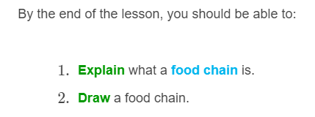
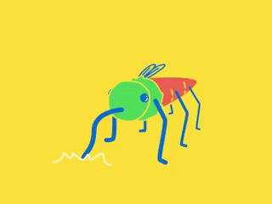

Slide 3

All living organisms need to consume some type of food for survival.
Food chains show the relationships between producers, consumers and decomposers.
They are a visual way of showing who eats what. The direction of the flow of energy in a food chain is shown by the direction of the arrow.

Slide 4
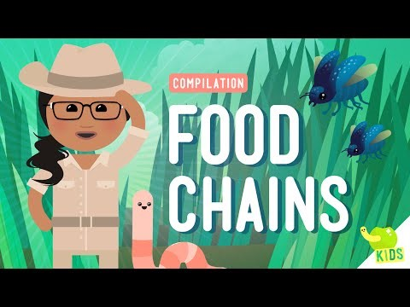

Slide 5
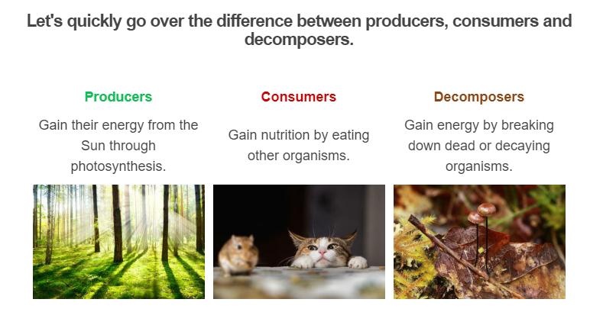

Slide 6
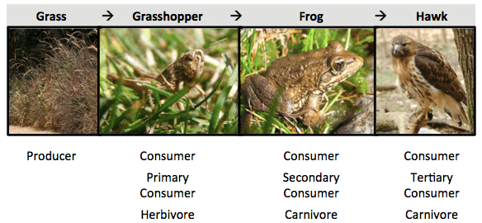
The arrows in food chains point from the organism that is being eaten to the organism doing the eating.
In the food chain below, the hawk eats the frog, the frog eats the grasshopper, and the grasshopper eats the grass.

Slide 7

Producers are always the first link in a food chain.
Animals that feed directly on producers are called first order or primary consumers (herbivores).
Animals that consume herbivores are second order or secondary consumers (carnivores or omnivores).
Third order (tertiary) consumers are at the top of the food chain - they are very rarely preyed upon by anything else.

